Slide 1
April Cyber Security Training
Evil Proxy, iSAMS MFA & Requiring Trusted Devices

Slide 2
Background
Second Office/iSAMS data breach within 2 years
Both breaches came from the same attack method
Multi-factor Authentication is NOT sufficient
This means:
More Training
Stricter Security Measures

Slide 3
Attack Summary
Targeting fee paying school’s
Often using already compromised accounts to spread phishing emails
Gain access to staff accounts with parent and hopefully iSAMS access
Use the account to email parents and trick them into paying fee’s early via fraudulent bank accounts, either targeted or in bulk
Bulk export parent contact details so they can continue to target parents after access has been revoked

Slide 4
Evil Proxy?

Slide 5
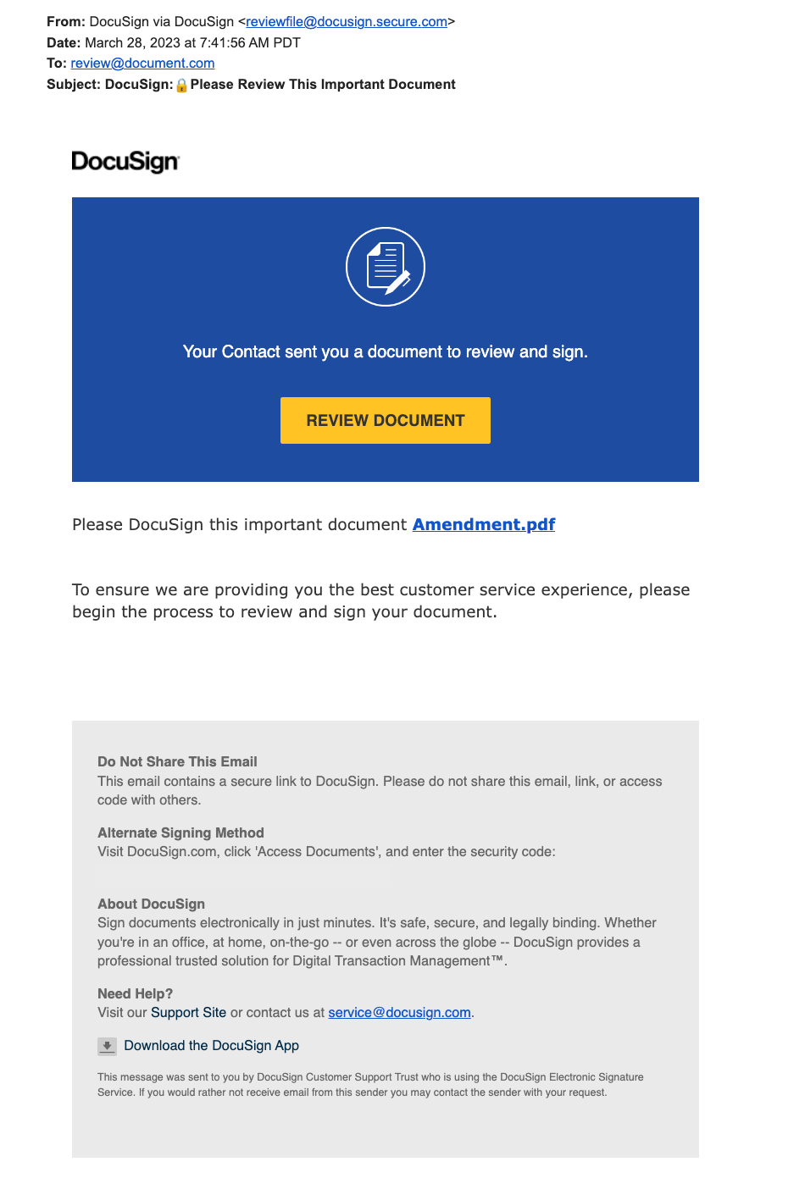
Step 1 – Phishing
Email with a malicious link
From random emails or legitimate users who have already been compromised
Often looks like well-known file sharing websites such as DocuSign, DropBox, Office 365, google docs etc…
Protect Yourself:
Hover over links before clicking
Are you expecting a file/link from this person?
Call IT Services for a quick sense check before clicking
Use the Phish Alert button to report phishing emails

Slide 6
Step 2 – Hijacked Browser Tab
Clicking the link takes you to a common webpage, not the one you might of expected
Youtube, BBC, Google Search etc…
Strange but harmless? You carry on with your day
Protect Yourself:
Close your browser window right away
Call IT Services immediately if unsure

Slide 7
Step 3 – Credential Theft
The browser tab randomly redirects the user to Office 365 and triggers an authentication
Can be after a random time or when you click on a link on the page
Login is a legitimate office login page
If you login now, your details are now compromised!
Protect Yourself:
NEVER login to office 365 unless you are expecting it and you initiated the login
NEVER login to office 365 with your school account when accessing files sent by someone outside of the School
Close your web browser right away and contact IT Services

Slide 8
Step 4 – Account Compromised
The attacker now has access to your current session credentials (Not your password!)
They will access Office 365 and register a new MFA device that they own
From here they can login whenever they want without a password or you knowing that your account is compromised.
Keep an eye out for suspicious behavior such as:
notifications for a new MFA device registered
emails being sent from outlook that you didn’t sent
new outlook rules

Slide 9
What is the School Doing to help?
iSAMS MFA for high risk users
Second layer of MFA when logging in to iSAMS, separate from Office 365 and highly unlikely to be compromised at the same time
No access to bulk export, bulk email and other functions unless enabled
Teaching staff will lose access to the functions above
Dramatically reduces the data that can be stolen and emails that can be sent
Require Trusted Devices
High risk staff will not be able to access Office 365 and linked services (iSAMS) unless they are on a School managed device
Laptops, Surfaces and School Issued Mobile phones
Personal phones will lose access to emails and outlook - we are working on a way to avoid this

Slide 10
Key Points
Evil Proxy
If you click an email link and it takes you somewhere unexpected, close and restart your web browser
Think before you login to Office 365 or use your school username and password. Is this correct? Is this expected?
Next Steps
iSAMS MFA - WC 22nd April 2024
Require Trusted Devices – May onwards

Slide 11
Questions?

