Slide 1
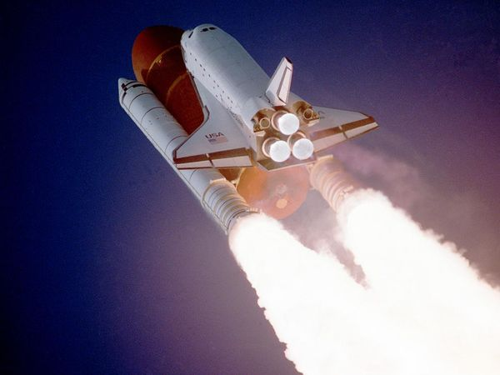
Momentum

Slide 2
What is Momentum?
Momentum is a quantity possessed by masses in motion.
It is a measure of how difficult it is to stop something that is moving.
momentum, ρ = mass, m x velocity, v
Ρ = m x v
(Units are kg m/s)
ρ
m
X
v

Slide 3
Momentum and acceleration
If an object is accelerating, its momentum must be increasing; acceleration causes a change in momentum of an object.
Newton discovered that the rate of change of momentum is proportional to the applied force.
If you double the force on an object, its momentum will change twice as quickly.

Slide 4
Momentum and acceleration
Initial momentum = mu
Final momentum = mv
Change in momentum = mv – mu
Rate of change of momentum = mv – mu
t

Slide 5
Momentum and acceleration
If we use standard units we can link the applied force and the rate of change in momentum:
Force = change in momentum
time taken
F = (mv – mu)
t

Slide 6
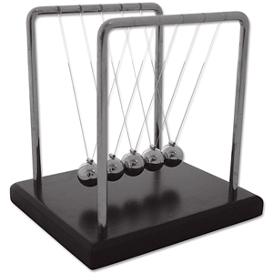
Momentum and Collisions
The momentum before a collision is always equal to the momentum after a collision.
This is referred to as the “Law of Conservation of Momentum”.
Newton’s Cradle allows us to see this in action.

Slide 7
Collisions
There are three types of collision:
Elastic– where no energy is lost in the collision, (eg between gas molecules)
Partially elastic – some energy is lost in the collision, (eg a bouncing ball)
Inelastic – where the objects collide and stick together

Slide 8
Car safety
Most of the safety features in a car are designed to increase the amount of time over which the car’s momentum changes in a collision.
Force = change in momentum
time taken
If the time is increased, the force experienced will be decreased.

Slide 9
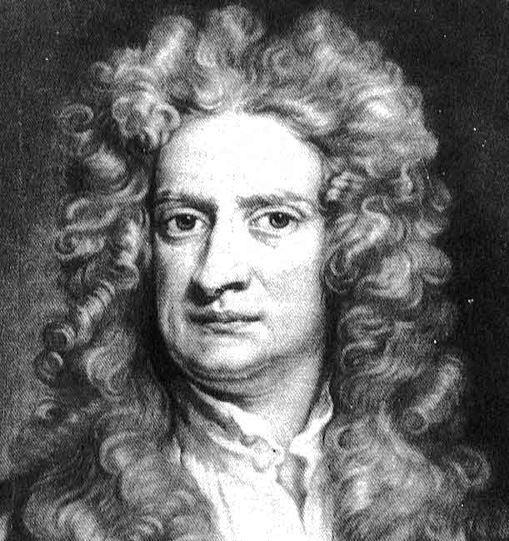
Newton’s Laws of Motion
A body will continue to move in a straight line at a steady speed unless acted upon by an external resultant force.
The rate of change of momentum of a body is proportional to the applied force.
For every action there is an equal and opposite reaction.

Slide 10
Newton’s Easy Laws of Motion
Things don’t speed up, slow down or change direction unless you push (or pull) them.
The bigger the force acting on an object, the faster it will accelerate; objects with greater mass need bigger forces than those will smaller mass to accelerate at the same rate.
When you push something it pushes back just as hard in the opposite direction.

