Slide 1
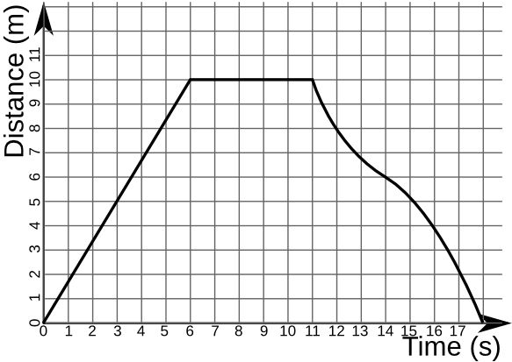
Distance-Time Graphs

Slide 2
What do they show?
A Distance-time graph allows us to plot the distance travelled by an object over a given time frame
It is a good visual representation of the movement of an object
The shape of the graph will tell us many things about the way the object was moving at any time

Slide 3
Reading a graph
Constant Speed
Getting Slower
Distance (m)
Distance (m)
Time (s)
Time (s)

Slide 4
Reading a graph
Getting faster
Stationary
Distance (m)
Distance (m)
Time (s)
Time (s)

Slide 5
Reading a graph
We can read:
How far the object has travelled at any time
How long the object took to travel a given distance
The gradient (slope) of the graph tells us how fast the object was travelling

Slide 7
What can you remember?

Slide 8
What do they show?
A Distance-time graph allows us to plot the distance travelled by an object over a given time frame
It is a good visual representation of the movement of an object
The shape of the graph will tell us many things about the way the object was moving at any time

Slide 9
Reading a graph
Constant Speed
Getting Slower
Distance (m)
Distance (m)
Time (s)
Time (s)

Slide 10
Reading a graph
Getting faster
Stationary
Distance (m)
Distance (m)
Time (s)
Time (s)

Slide 11
Reading a graph
We can read:
How far the object has travelled at any time
How long the object took to travel a given distance
The gradient (slope) of the graph tells us how fast the object was travelling

