Slide 1
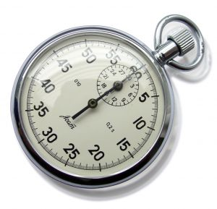
Velocity-time graphs

Slide 2
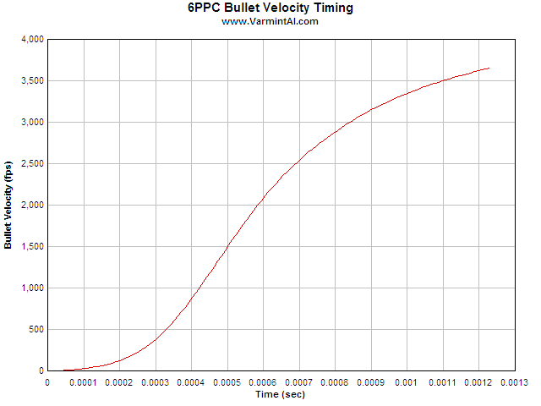
What do they show?
A velocity-time graph shows us how the velocity of an object varies with time
It is a good visual representation of the velocity of an object
The shape of the graph will tell us many things about the way the object was moving at any time

Slide 3
Reading a graph
Constant Velocity
Constant Acceleration
Velocity (m/s)
Velocity (m/s)
Time (s)
Time (s)

Slide 4
What’s happening?
Velocity (m/s)
Velocity (m/s)
Time (s)
Time (s)

Slide 5
Reading a graph
We can read:
The velocity of an object at any time
How long the object travels at a given velocity
The gradient (slope) of the graph gives us the acceleration of the object
The area under the graph gives us the distance travelled by the object

Slide 6
Velocity or distance?
It is very important to look at the axes of these graphs
Distance-time graphs and velocity-time graphs can look very similar
However, they tell us very different things
ALWAYS check what kind of graph it is before making any calculations

Slide 8
What can you remember?

Slide 9
What do they show?
A velocity-time graph shows us how the velocity of an object varies with time
It is a good visual representation of the velocity of an object
The shape of the graph will tell us many things about the way the object was moving at any time

Slide 10
Reading a graph
Constant Velocity
Constant Acceleration
Velocity (m/s)
Velocity (m/s)
Time (s)
Time (s)

Slide 11
What’s happening?
Velocity (m/s)
Velocity (m/s)
Time (s)
Time (s)

Slide 12
Reading a graph
We can read:
The velocity of an object at any time
How long the object travels at a given velocity
The gradient (slope) of the graph gives us the acceleration of the object
The area under the graph gives us the distance travelled by the object

Slide 13
Velocity or distance?
It is very important to look at the axes of these graphs
Distance-time graphs and velocity-time graphs can look very similar
However, they tell us very different things
ALWAYS check what kind of graph it is before making any calculations

