Slide 1
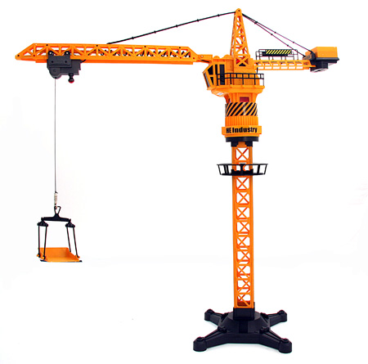
Turning Effect of forces

Slide 2
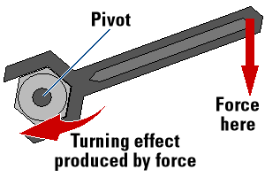
Levers
Levers operate a force around a fixed point.
This point is called a pivot or a fulcrum.
The force is no longer linear, it is rotational.
We call this turning effect a Moment.

Slide 3
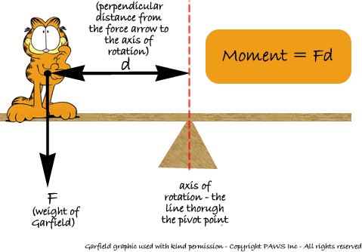
Moments
A moment can be calculated by:
Moment = force (N) x distance from pivot (m)
The units are Newton metres (Nm)

Slide 4
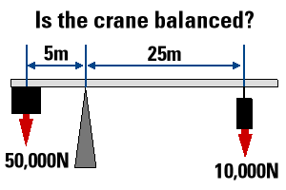
Balance
When an object is balanced,
sum of anticlockwise moments
=
sum of the clockwise moments
We see this in see-saws, cranes.....

Slide 5
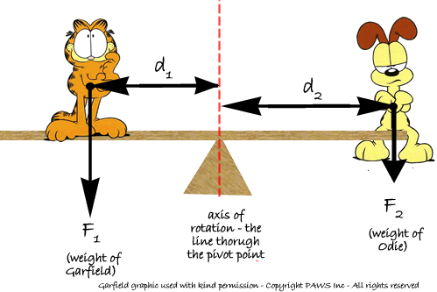

Slide 6
Centre of Gravity
The centre of gravity of an object is the point at which all the weight of the object appears to act.
At this point, the moments will be balanced.
If an object is pivoted outside the centre of gravity, then the weight of the object will produce a moment about the pivot.

Slide 7
Stability
If the centre of gravity sits outside the base of the object, it will be unstable.
The weight of the object will cause it to move or fall.
A wide base with a low centre of gravity is most stable.

