Slide 1
Updated Behaviour Policy
2024

Slide 2
Why the changes
Align our behaviour policy with our new vision and values
Mobile phones government guidance document in 2024 stated:
‘we are determined that all schools should prohibit the use of mobile phones throughout the school day – not only during lessons but break and lunchtimes as well.’
Clear consequences for repeated behaviour

Slide 3
Concerns
Same as in previous years
Staff to log under correct category on iSAMS
Numbers of concerns shown on reports

Slide 4
Level 1
Level 2

Slide 5
Level 3
Level 4

Slide 6
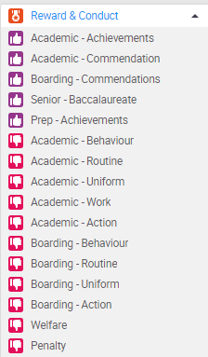
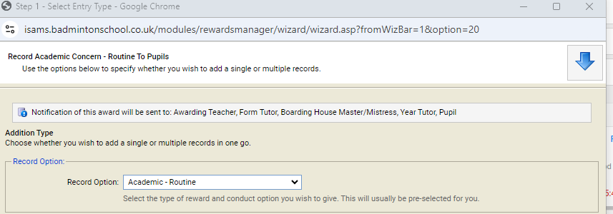
Logging concerns
Academic/Boarding – Behaviour and Penalty logs do not get emailed to pupils
Use the Action/Follow up with pupils to record discussions.

Slide 7
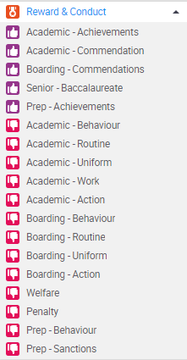
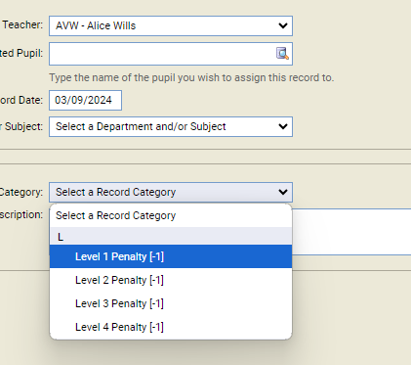
Logging a penalty

Slide 8
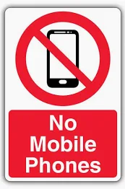
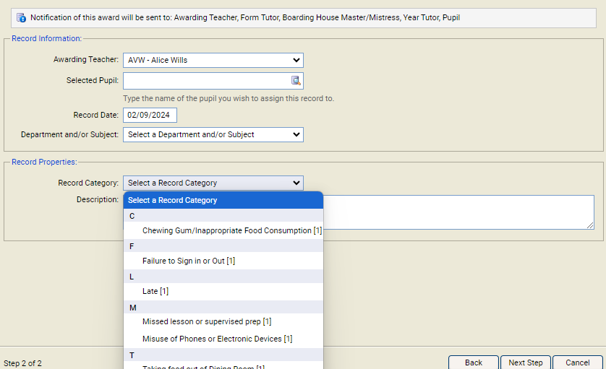
Phones and Devices
Year 7 – 11
Phones not to be seen at any point during the school day (including common rooms)
This includes use in classrooms
If staying after school, may bring them to prep and are to ask the staff member on duty if they need to use it to contact home.
Sixth Form
May only use them when within the Sixth Form Centre
Common rooms – device free!
Staff to confiscate phones if seen – take to School Office
Staff modelling this policy
Log use of phone on iSAMS under ‘Academic –Routine
Escalation to a Level 2 Penalty – handing in phone for one week if 3 x misuse of phone in a half term.

Slide 9
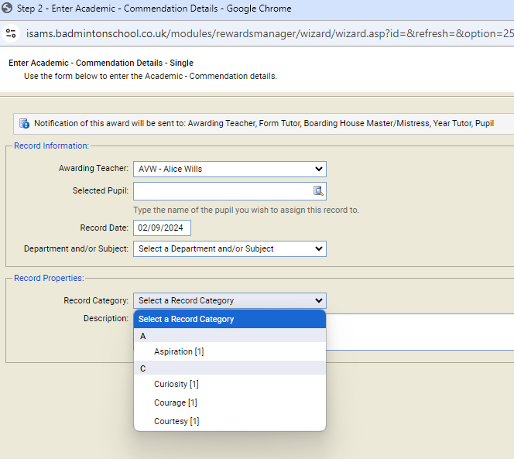
Commendations
Log under one of our 4 values
Aspiration
Curiosity
Courage
Courtesy

