Slide 1
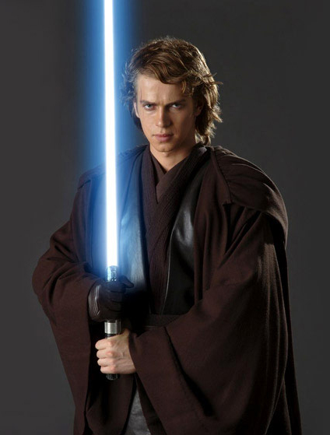
Forces
Friction

Slide 2
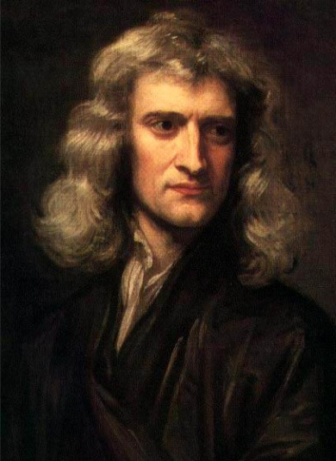
What are forces?
Forces are always pushes or pulls
Forces have both size and direction – they are vectors
Units of force are newtons (N)
A force of one newton will make a mass of one kilogram accelerate at one metre per second squared
Forces can be defined as contact and non-contact

Slide 3
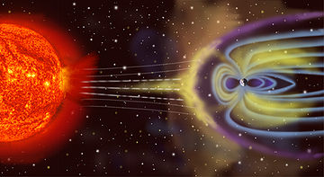
Types of force
Contact forces
Non-contact forces
Friction
Air resistance
Water resistance
Upthrust
Gravity
Magnetism
Electrostatic

Slide 4
Balanced and Unbalanced
Usually there is more than one force acting on an object
If the forces are balanced they cancel each other out:
If the forces are unbalanced, the object will change velocity, direction or shape:
10 N
0 N = steady state
10 N
10 N
5 N
5 N

Slide 5
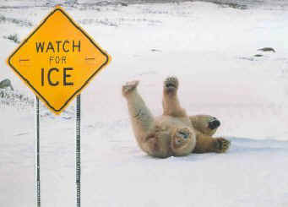
Friction
Friction is the force that acts on an object to oppose motion
Kinetic energy is converted to heat as work is done by the friction force
Friction occurs when solid objects rub against each other and when objects move through fluids

Slide 6
Working with Friction
Reducing Friction
Increasing Friction
Machines are more efficient, (less energy lost as heat)
Objects experience less wear and tear
Vehicles need less fuel
Objects can travel faster
Allows tyres to grip roads better
Brakes are more effective
Allows parachutes to work
Enables movement of objects

Slide 7
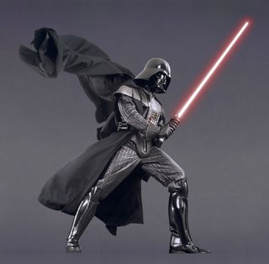
Forces
Mass and Acceleration

Slide 8
Acceleration
An object will not accelerate (change its velocity) unless there is an unbalanced force acting on it
The rate of acceleration depends upon the unbalanced force and the mass of the object
If the forces are balanced, the object will remain at a steady state, (constant velocity)

Slide 9
Force, mass, acceleration
The harder we push something the faster it goes:
F α a
The more massive an object, slower it will accelerate:
a α 1
m

Slide 10
Force, mass, acceleration
If we combine these relationships we are left with the formula:
force, F = mass, m x acceleration, a
F = m x a
F
m
X
a

Slide 11
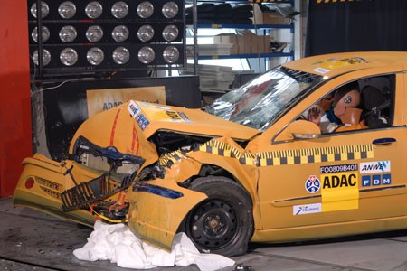
Force, mass, acceleration
One newton is the force required to make a mass of one kilogram accelerate at one metre per second squared.
A negative acceleration is a deceleration

Slide 12
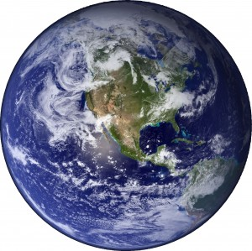
Weight
The weight of an object is the force that acts on it because of gravity.
Remember: weight and mass are NOT the same thing.
We can use our equation F = ma, but in this case the acceleration is caused by gravity, g

Slide 13
Weight
Therefore weight can be calculated as:
weight, W = mass, m x acceleration due to gravity, g
W = m x g
The value of g depends on how strong a planet’s gravity is, so whilst the mass of an object remains constant it’s weight can change.

